Slide 1

MSSE 661: NANOSITE PRESENTATION
COLLEGE OF Computer & Information Sciences
By Hamilton Nguyen

Slide 2
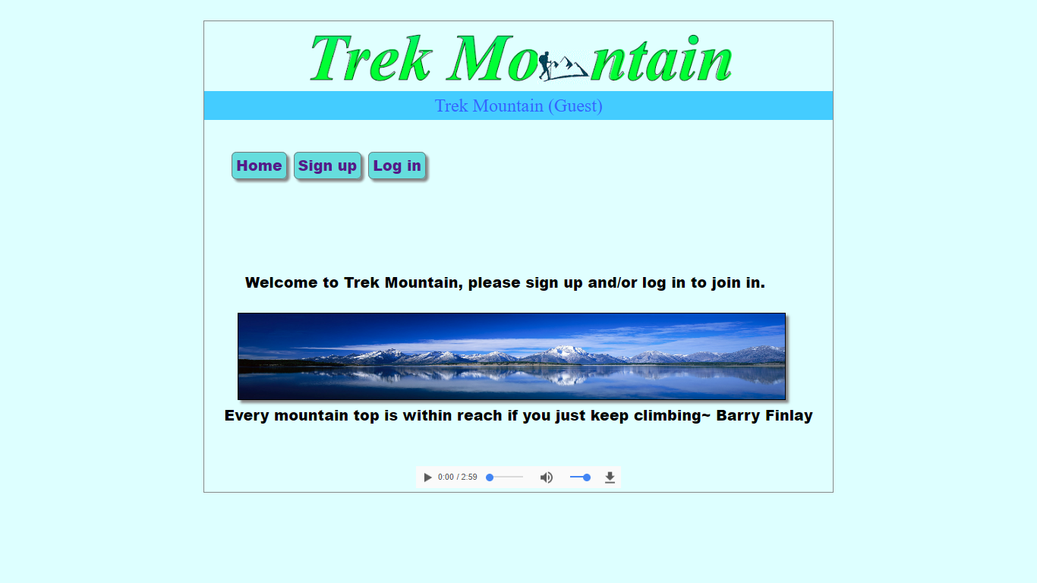
Home/index page

Slide 3
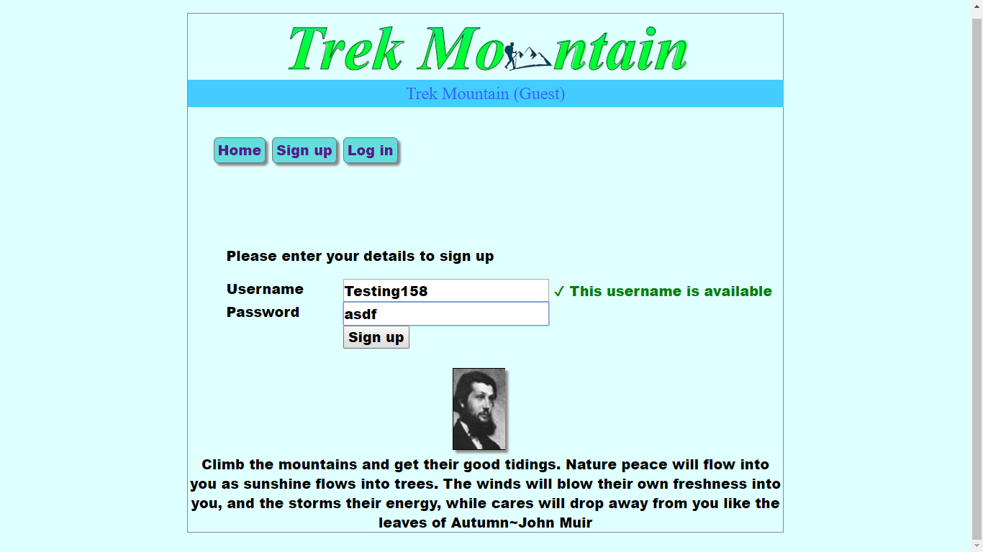
signup page

Slide 4
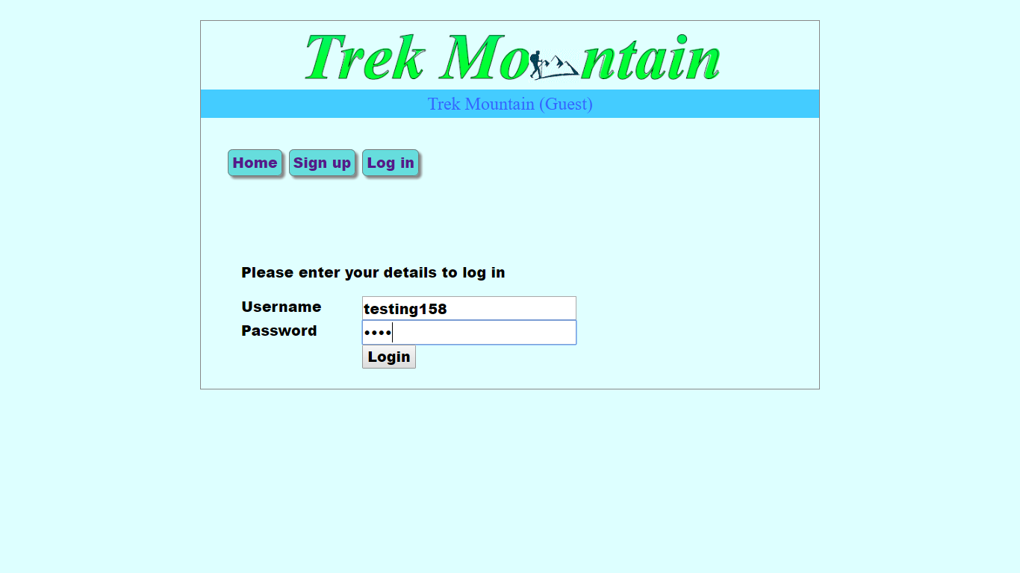
Login page

Slide 5
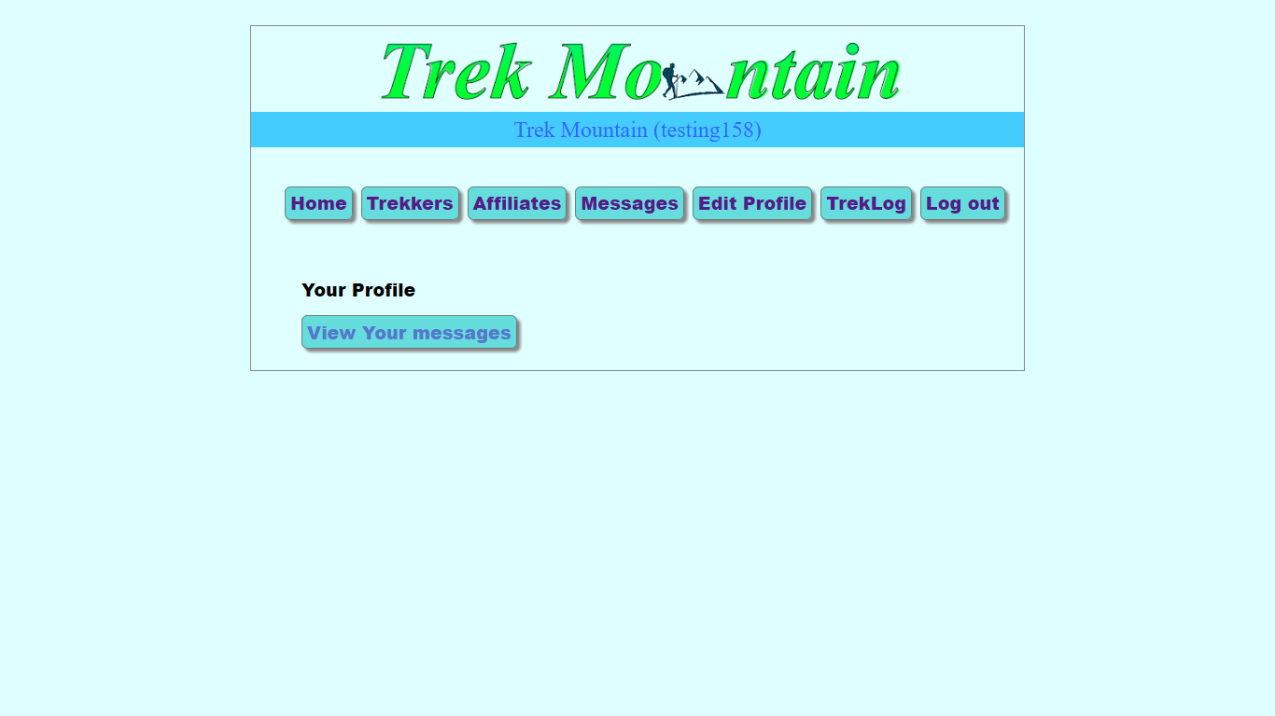
Profile page

Slide 6
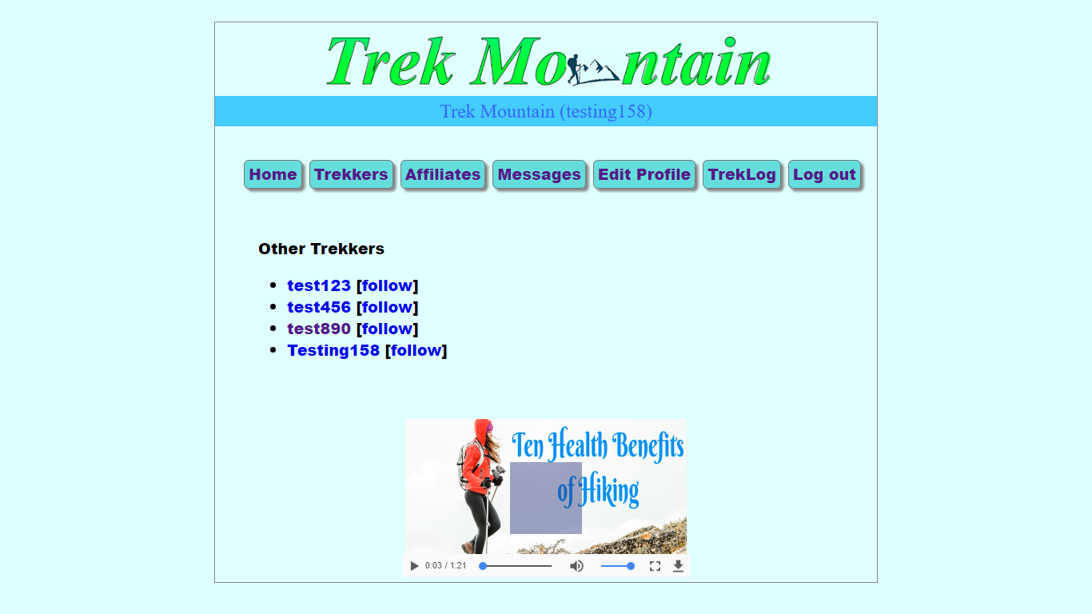
Trekkers- (registered users) page

Slide 7
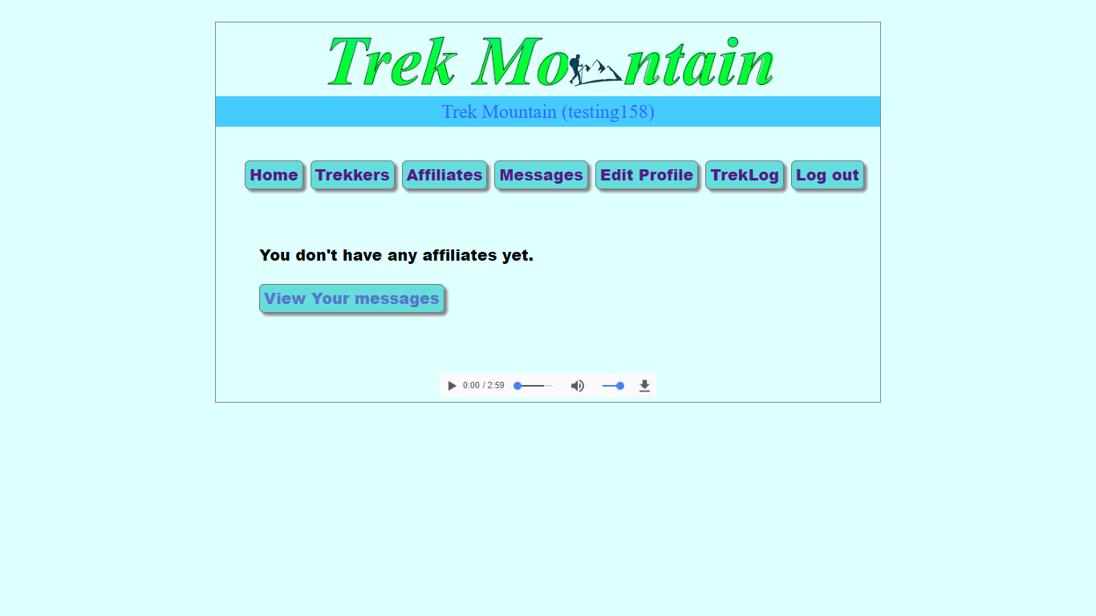
Affiliates page

Slide 8
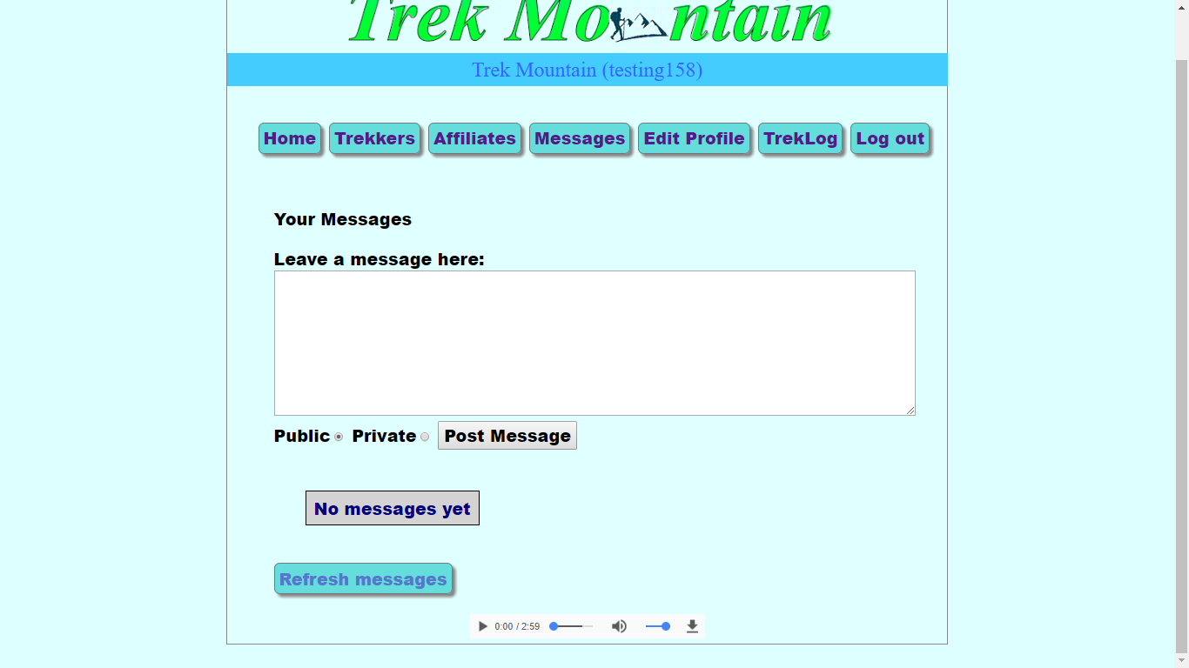
Messaging page

Slide 9
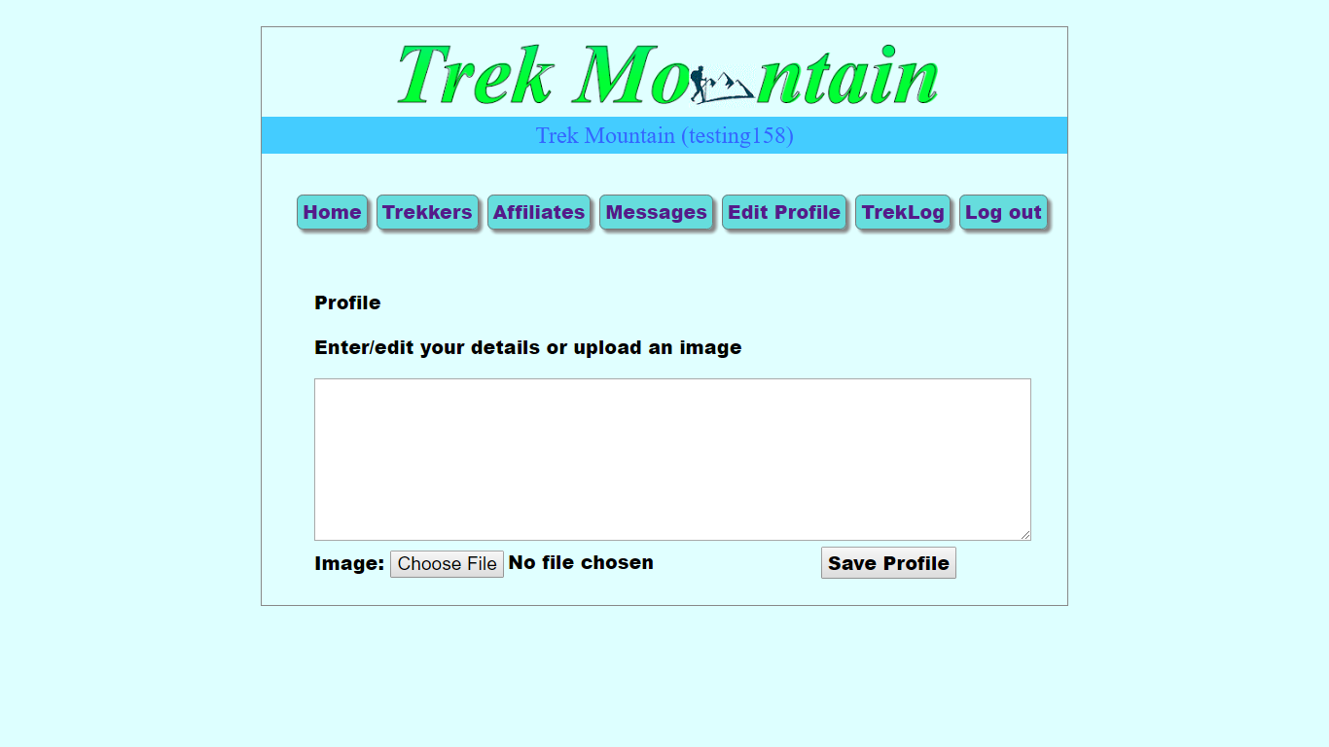
Edit profile page

Slide 10
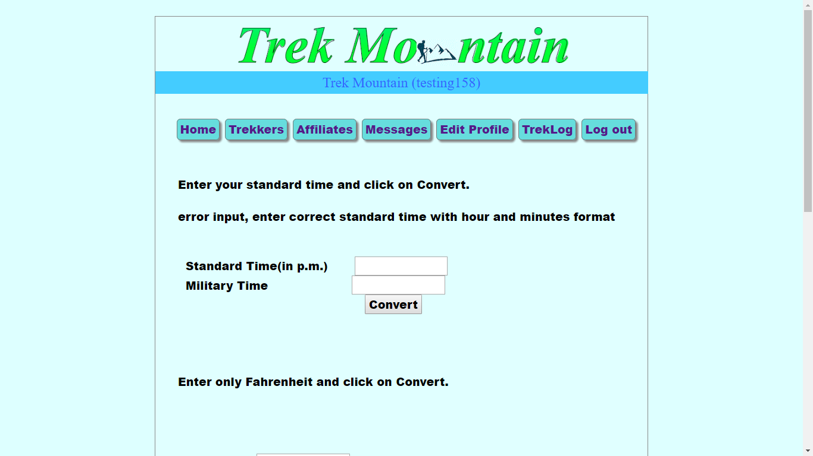
Treklog page part I

Slide 11
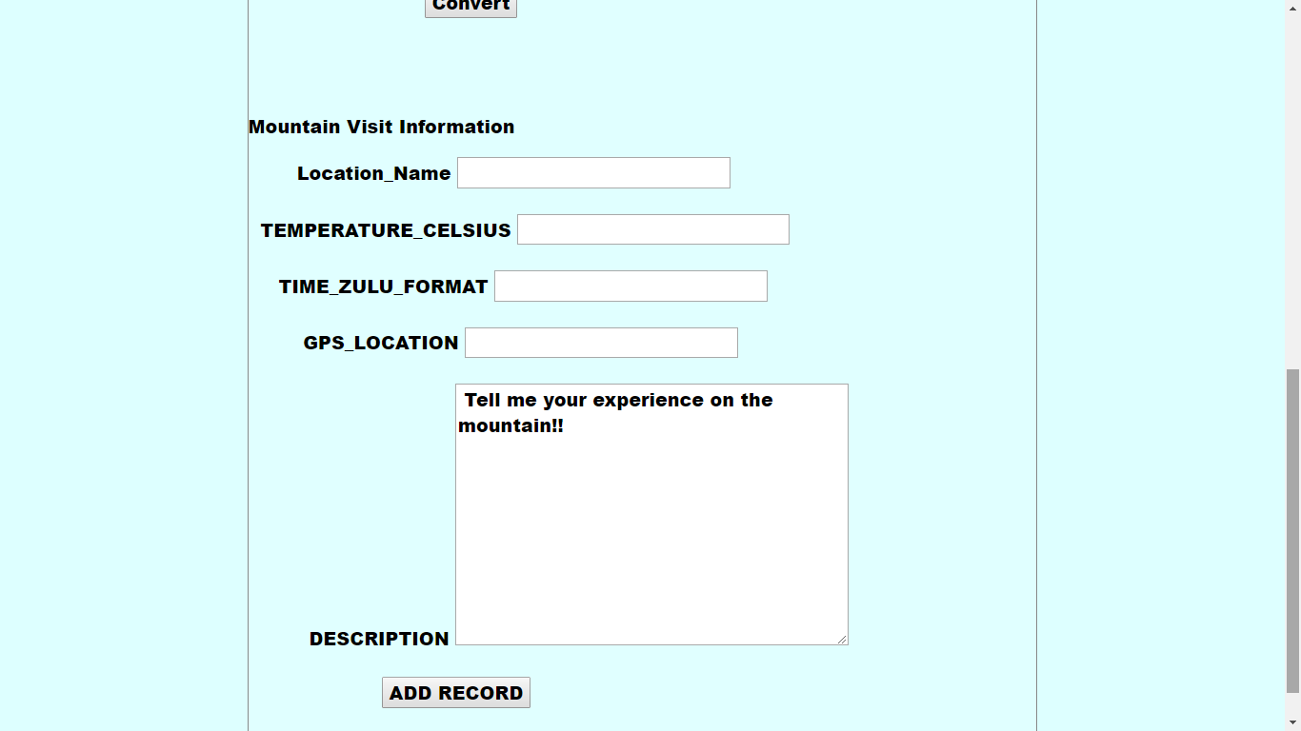
Treklog page part II

Slide 12
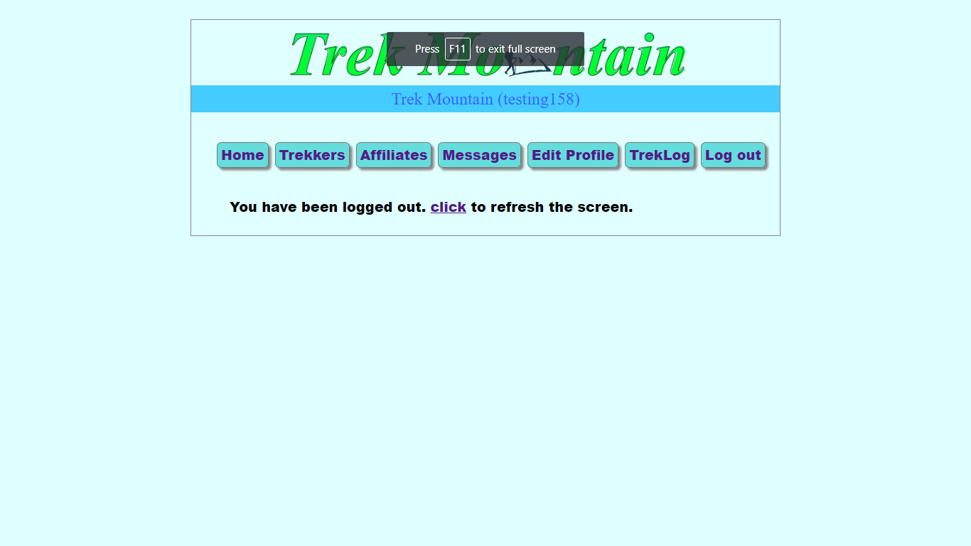
Logout function

